Slide 1
Midterm Proposal
Tayleur’s Personal Website
Introduction
Best Shots Page
(Photography)
Resume Page
Best Essays

Slide 2
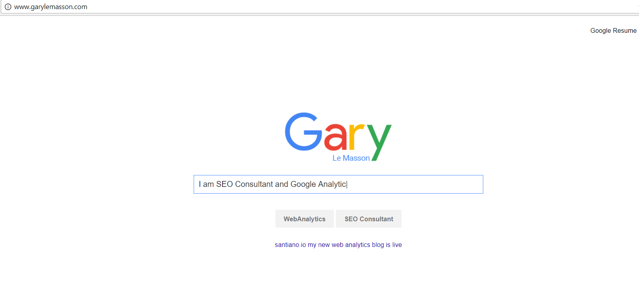
http://www.garylemasson.com/

Slide 3

Pinterest Mood Board

Slide 4
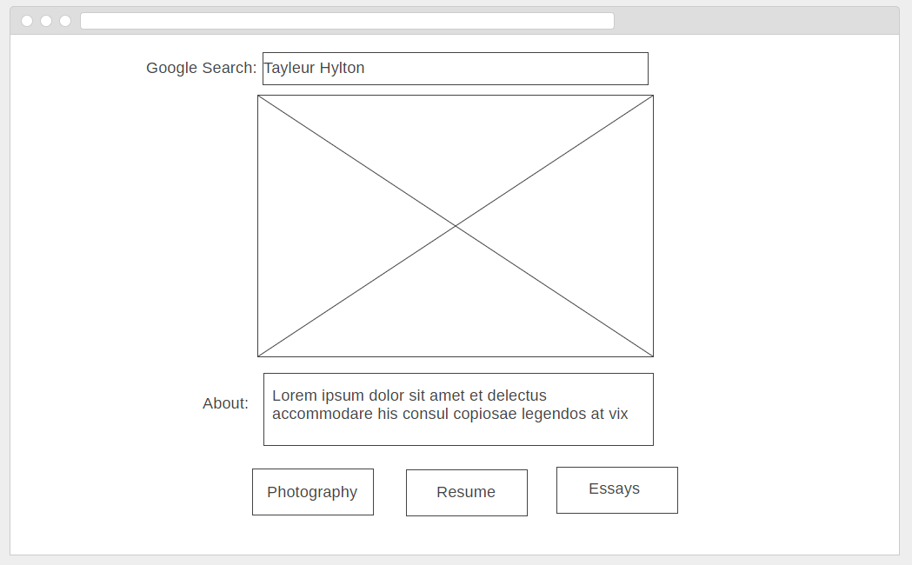

Slide 5
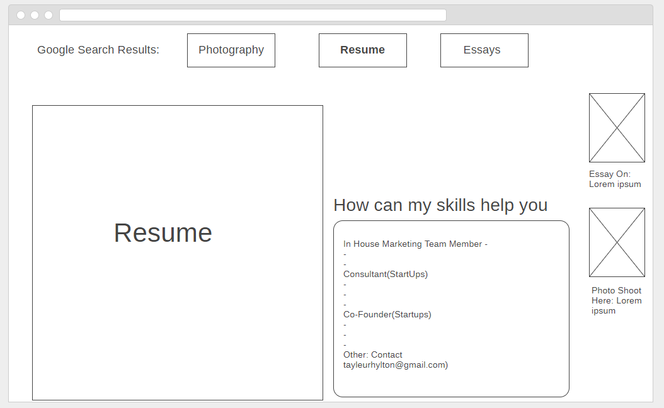

Slide 6
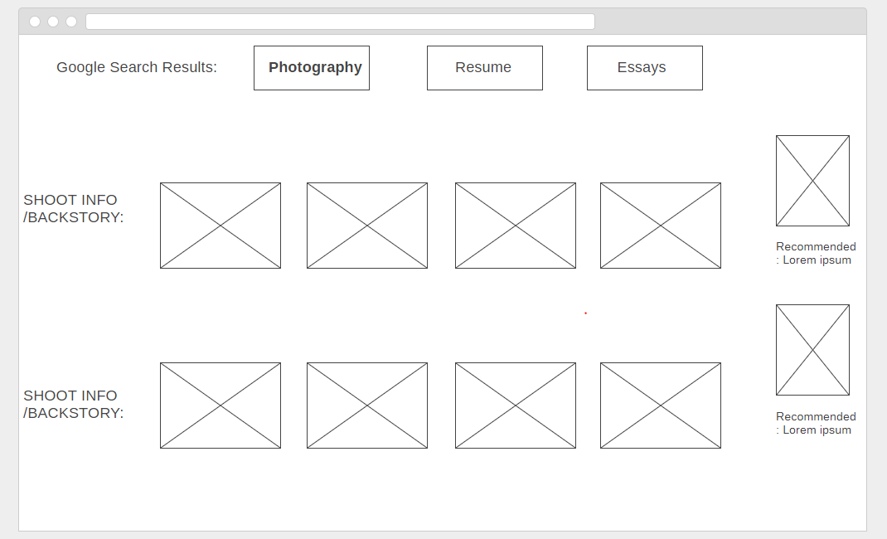

Slide 7
